Slide 1
Class 8: Linear Regression 2, Electric Boogaloo
MGSC 310
Ben Labaschin

Slide 2
Class 8: Outline
Hypothesis testing and p-values
Hypothesis testing and p-values: to the code!
Standard Errors, Confidence Intervals, and Z/t -scores
Model Fit: R²
Model Evaluation:Test/Training Sets, Bias/Variance, MSE, RMSE
Lab 8

Slide 3
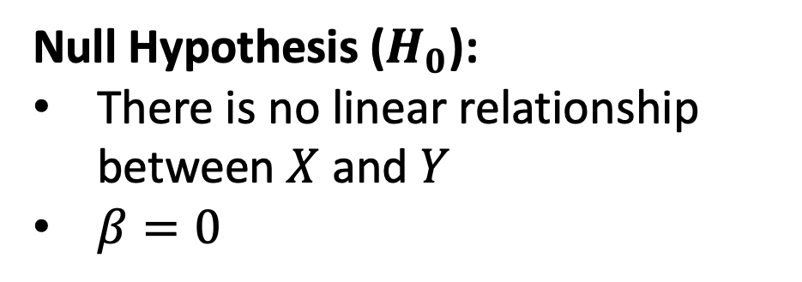
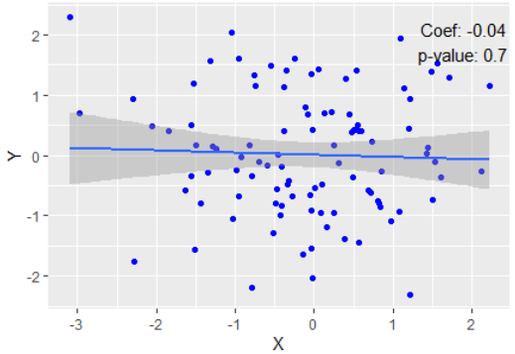
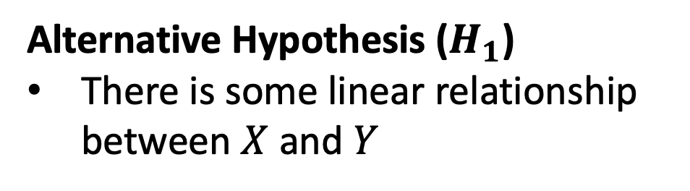
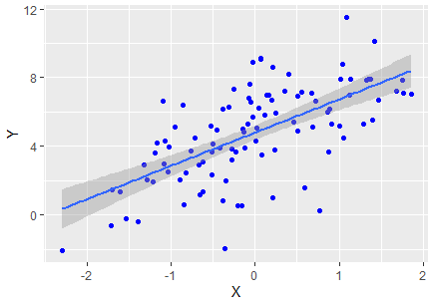
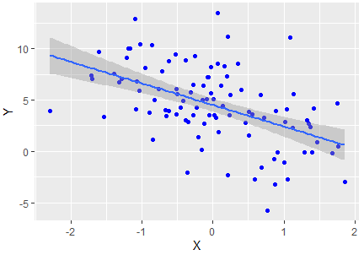
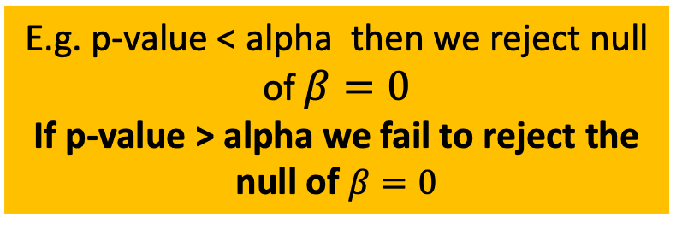
Hypothesis Test for Coefficients
We either reject the null hypothesis or fail to reject the null hypothesis
Based on a chosen critical value of alpha

Slide 4
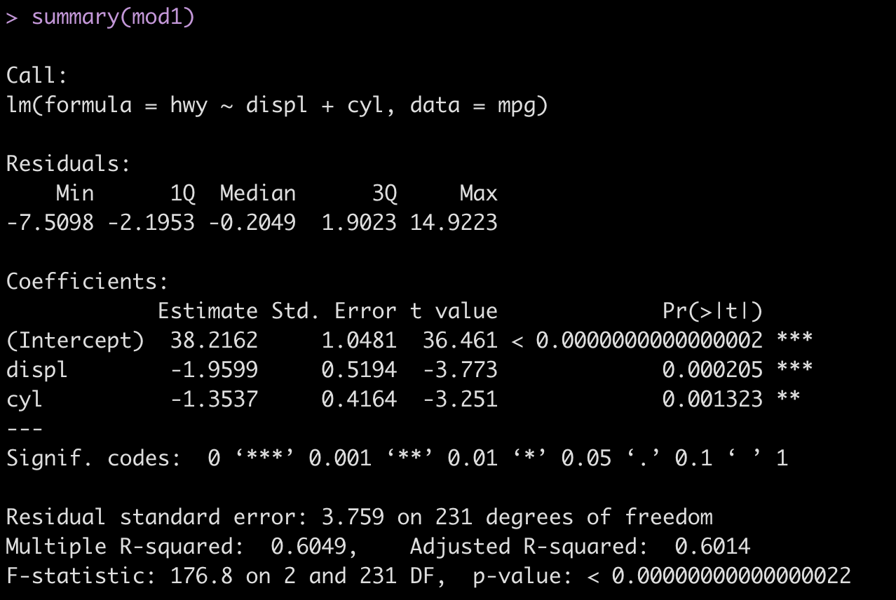
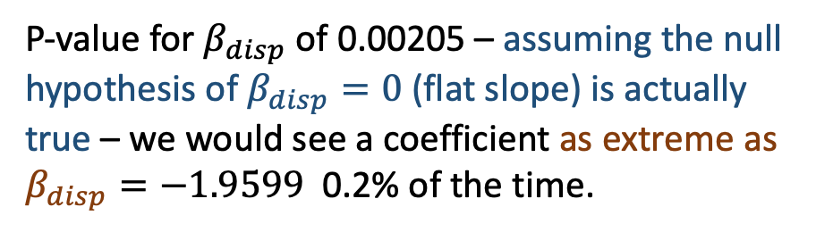
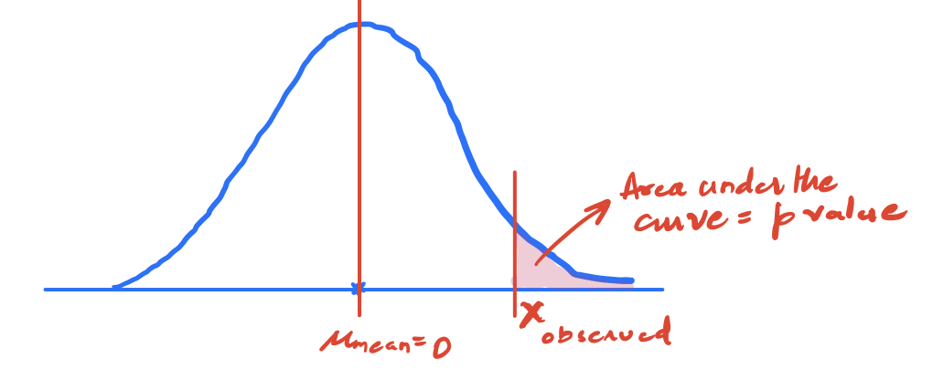
What Do p-values Measure?
P-value tells us the likelihood that, if the null hypothesis were true, we would receive a result as extreme as the one seen
Why? There’s always uncertainty and noise when we estimate a parameter.
The more data we have, and the stronger the impact of displacement the more likely we are to find low p-values (e.g. there is some effect)

Slide 5
Hypothesis Testing and P-Values
To the code!

Slide 6
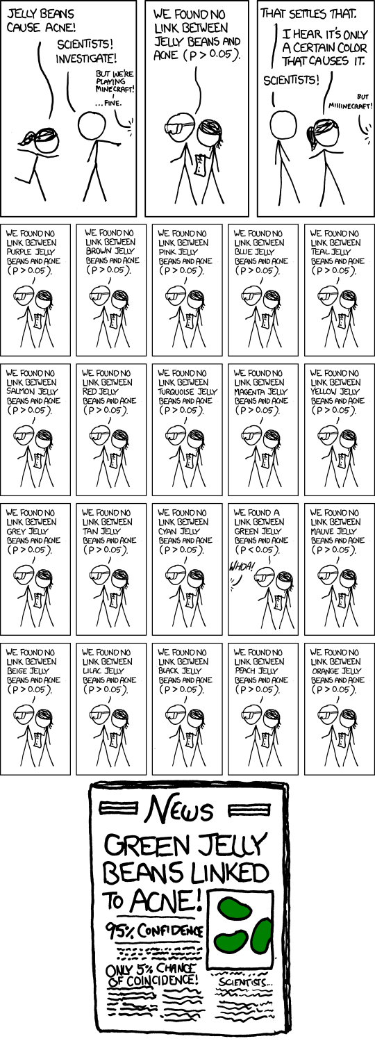
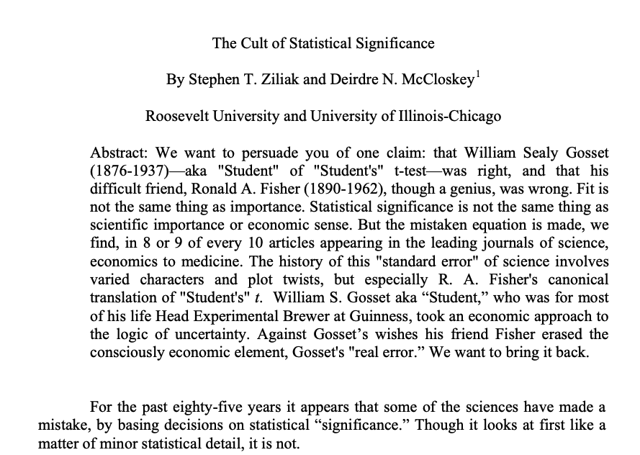
Issues with Statistical Significance
Statistical Significance, xkcd: https://xkcd.com/882/
Suggested Reading: The Cult of Statistical Significance (McCloskey, 2009)

Slide 7
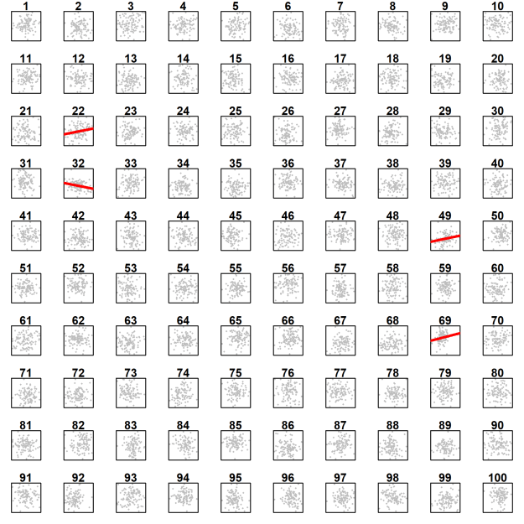
Why shouldn’t we use p-value cutoffs of 0.05 for big data (many variables or many rows)?
Suppose we estimated a model predicting y using 100 “noise” variables, each of which where the true effect is 0. (e..g. each variable has no impact on y).
If we use p-value < 0.05 as a cutoff, we will incorrectly reject the null hypothesis (e.g. think there is an effect of that variable when there isn’t) for 5 out of 100 variables
Imagine you estimate a model with 1000 noise variable. If you use the p-value cutoff of 0.05 how many will you find are “statistically significant”?
Imagine you test 1000 cancer drugs, each of which has no effect, and use a 0.05 “statistically significant” p-value cutoff. How many cancer drugs will you approve that have no effect on someone’s health?

Slide 8
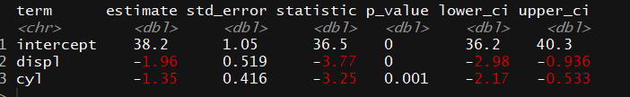
What About Standard Errors (English) ?
KNOW THIS!!!
Standard Error (SE):
Measures how much an average from a sample might differ from the average of the whole population.
Meaning:
Reflects the fluctuation of the coefficient across different samples, estimates how it might "wobble" due to random chance.
Approximation of Precision:
Think of SE as a magnifying glass: it gauges the clarity of our coefficient.
Smaller SE = Sharper Picture:
If SE is small in relation to the coefficient: Our estimate is like a sharp photo — more precise.
Big SE? The picture might be a bit blurry — less certainty about the exact value.

Slide 9
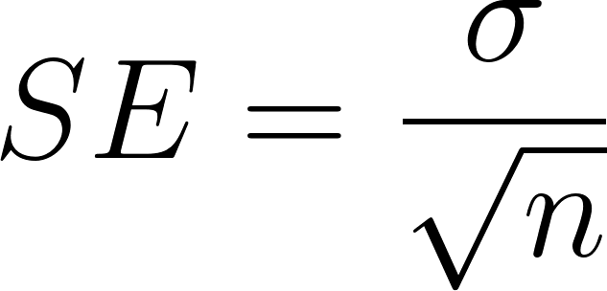
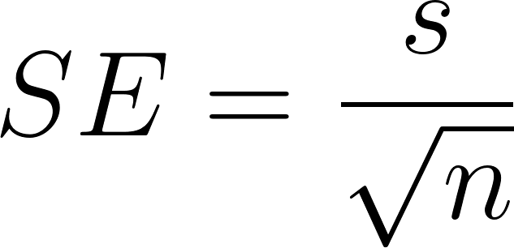
What About Standard Errors (Math) ?
KNOW THIS!!!
Standard Error (SE) (Population):
The standard error (SE) of the sample mean for a population with known standard deviation (σ) and sample size (n) is:
You’ll rarely use this, as you generally don’t have access to the population
Standard Error (Sample Mean) [Use this one]
If the population standard deviation (σ) isn't known (which is more common), and you're using the sample standard deviation instead:
Tip: Use population standard deviation (σ) when you have data for the entire group; use sample standard deviation (s) when working with a subset of the group.

Slide 10
What About Confidence Intervals (English) ?
Confidence Interval (CI)
Provides a range where the true average (or other parameter) of the whole population is likely to be.
Meaning
If we were to repeat our sampling process 100 times and calculate a 95% confidence interval for each sample, we expect about 95% of those intervals to contain the true parameter.
Approximation of Reliability
Think of CI as a safety net: it captures the range where the true value might lie.
Narrow CI = Greater Confidence
Wide CI? More Uncertainty

Slide 11
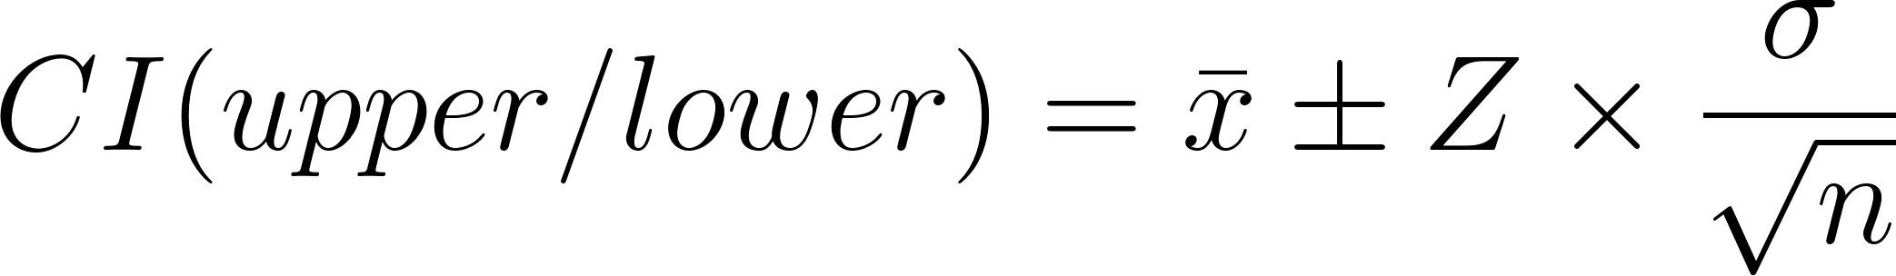
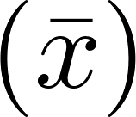
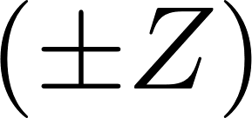
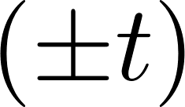
What About Confidence Intervals (Math) ?
Confidence Interval (CI) (Population):
The formula for the confidence interval (CI) when the population standard deviation (σ) is known and the same size is (n) is:
Where is the sample mean and is the Z-value corresponding to the desired confidence level.
You’ll rarely use this, as you generally don’t have access to the population
Confidence Interval (CI) (Sample Mean) [Use this one]:
If the population standard division isn’t known (more common), and you’re using the same standard deviation (s) instead:
Where is the sample mean and is the t-value corresponding to the desired confidence level.

Slide 12
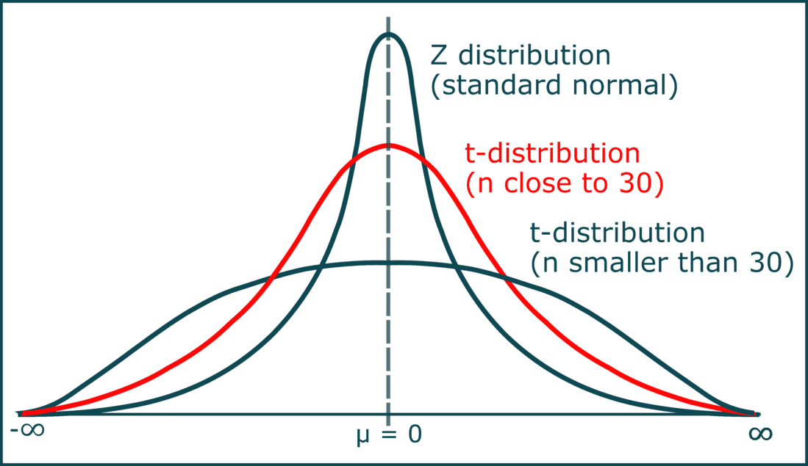
On Distributions: Z and t

Slide 13
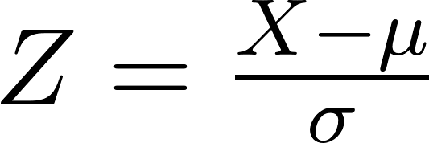
What About Z-scores?
Z-Value (Z-score)
Represents how many standard deviations a data point is from the mean in a standard normal distribution (mean = 0, standard deviation = 1).
Formula
X = sample, 𝝁 = population mean, 𝞼 = standard deviation
Meaning & Use
Standardization: Converts raw data points in a dataset into “standard form” (normal)
Position: Indicates relative position to the mean (in a normal distr.)
Confidence & Hypothesis Testing: Used in determining tail probabilities and critical values when population standard deviation is known.

Slide 14
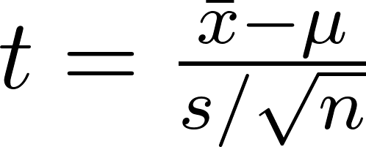

What About t-scores?
T-Value (t-score)
Represents how many standard errors a sample statistic (like sample mean) is from the population a parameter in a t- distribution .
Formula
= sample mean, 𝝁 = population mean, s = sample standard deviation, n = sample size
Meaning & Use
Distribution: Follows the t-distribution, which is wider and flatter than the standard normal distribution.
Confidence & Hypothesis Testing: Critical values for t-tests, and constructing confidence intervals when the sample size is small or population standard deviation is unknown.
Large t-stat in abs value -> big effect size

Slide 15
Model Fit: R² (English)
KNOW THIS!!!
Coefficient of Determination (R²)
Represents the proportion of the variance for the target (dependent) variable that's explained by feature (independent) variables.
Variance Explanation
R² quantifies the degree to which the independent variable(s) predict the variation in the dependent variable.
In other words: When a model explains variance, it is fair to say that it is predictive of how changes to input quantities (features) will affect output quantities (targets).
Model Goodness of Fit
Model Goodness of Fit: A higher R² indicates that the model fits the data better. However, adding more predictors can artificially inflate R².
0 ≤ R² ≤ 1
A value of 0 indicates the model does not explain any of the variation, while a value of 1 indicates it explains all the variation.

Slide 16
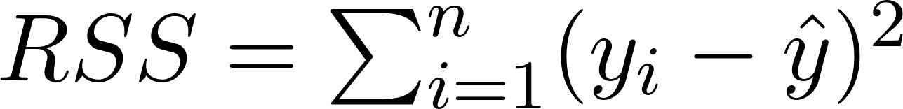
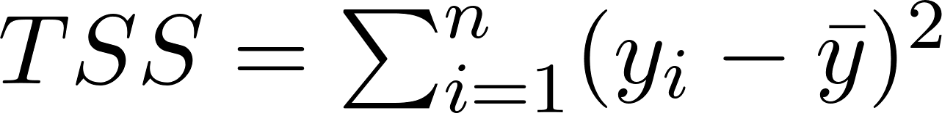
Model Fit: R² (Math)
KNOW THIS!!!
Coefficient of Determination (R²)
Represents the proportion of the variance for the target (dependent) variable that's explained by feature (independent) variables.
Formula
Where

Slide 17
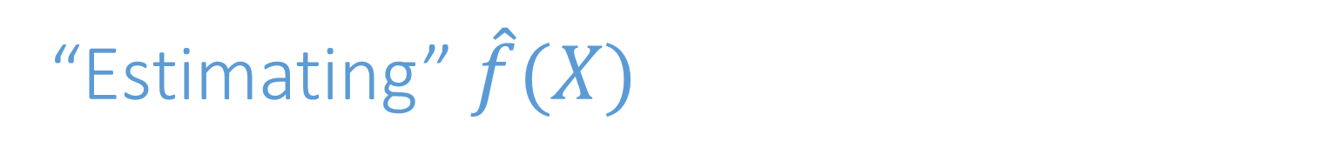
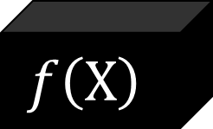
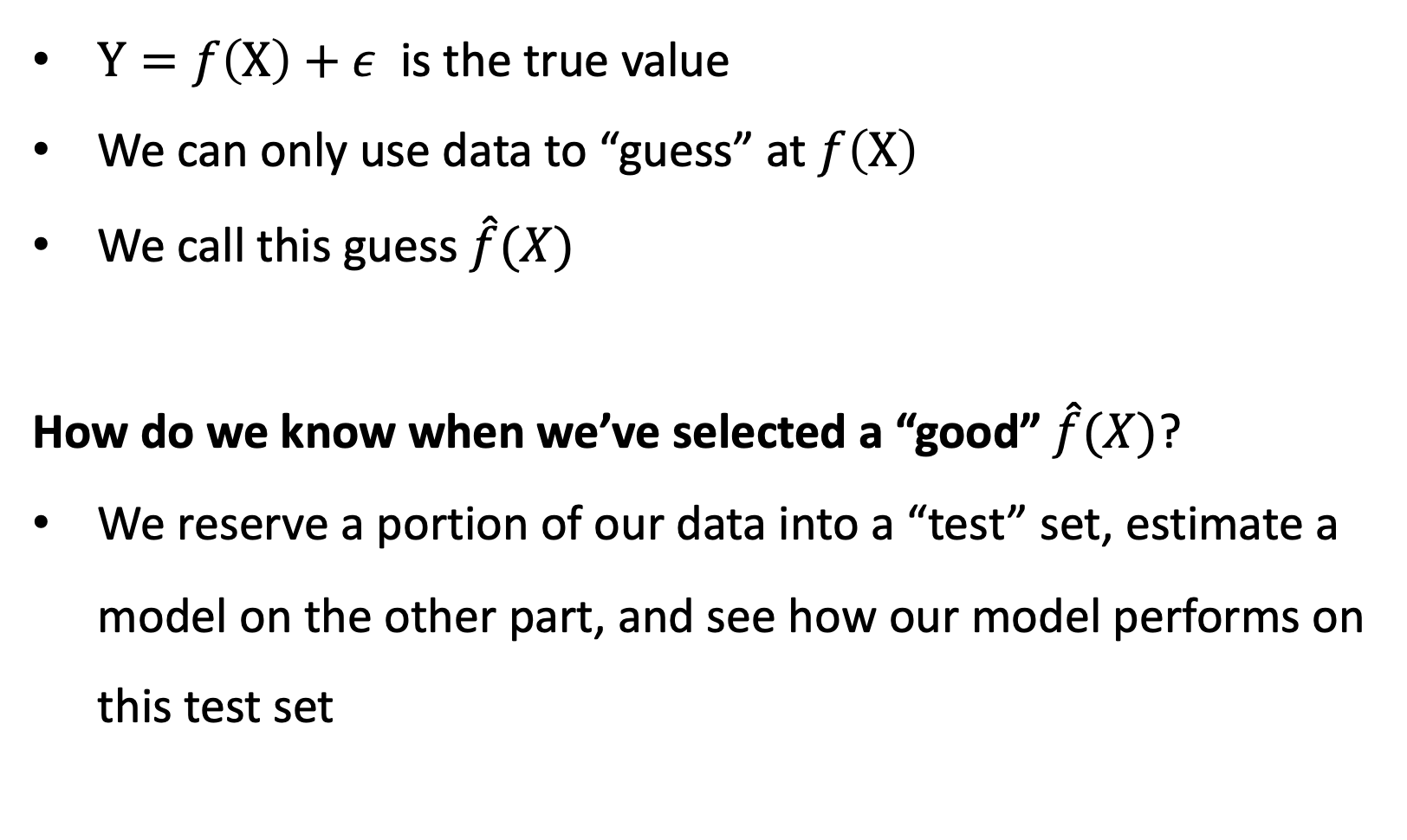

Slide 18
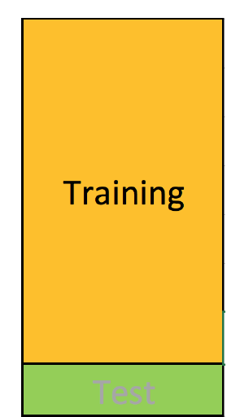
Testing Training Data Subsets
Training set: (observation-wise) subset of data used to develop models

Slide 19
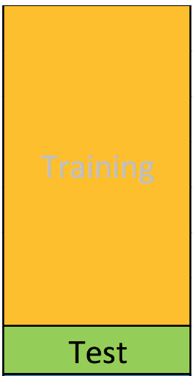
Testing Training Data Subsets
Training set: (observation-wise) subset of data used to develop models
Test set: subset of data used to assess machine learning model performance at end of modeling process
Rule of thumb 80% training 20% test -ish

Slide 20
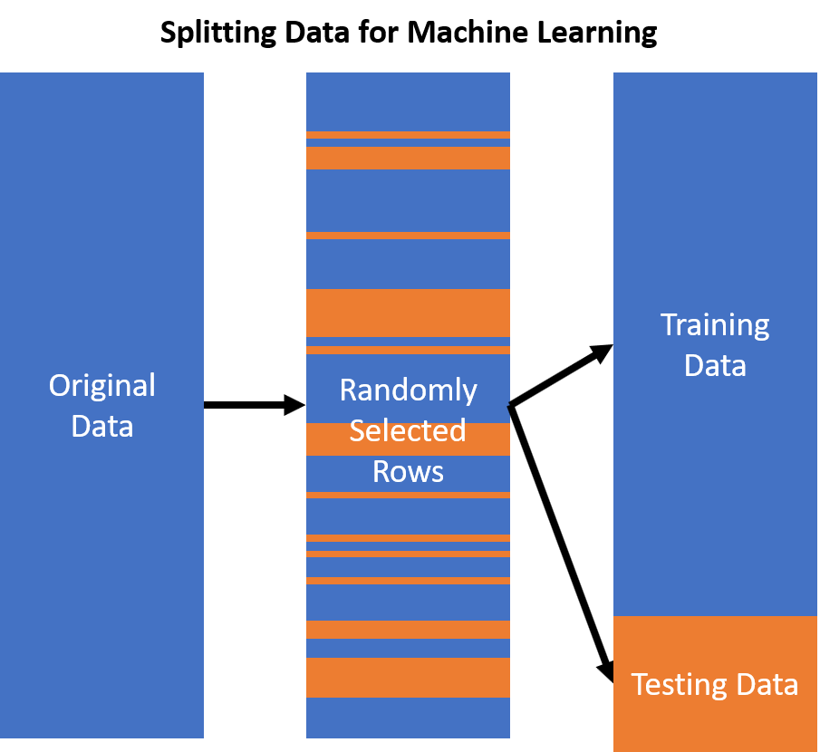
Randomly Selecting Rows for Test or Training Sets
Observations are randomly selected into either testing or training splits of the data

Slide 21
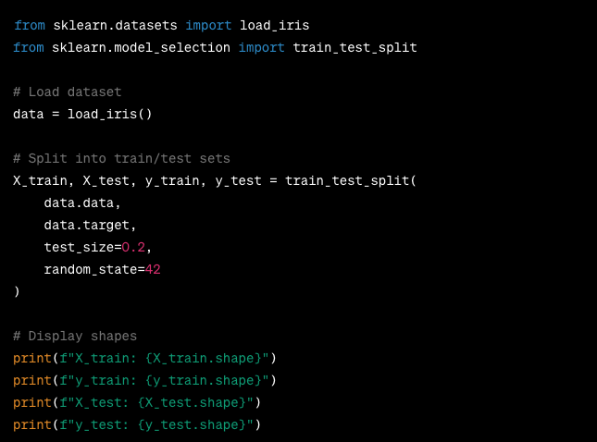
Building Testing and Training Sets in Python

Slide 22
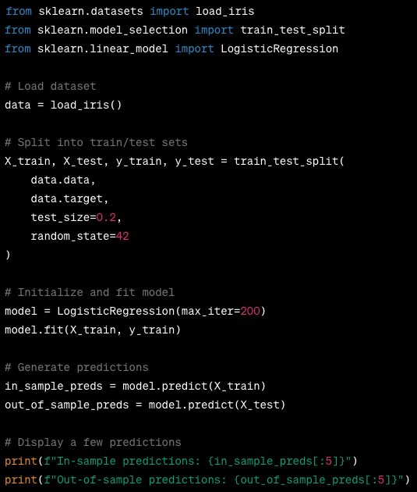
Generating In-Sample (Training) and Out-of-Sample (Test) Predictions
Estimate a model on the training set
Never estimate a model on the test set
In-sample predictions are the predictions using data in the training set (X_train)
Out-of-sample predictions are the predicts using data in the test set (X_test)

Slide 23
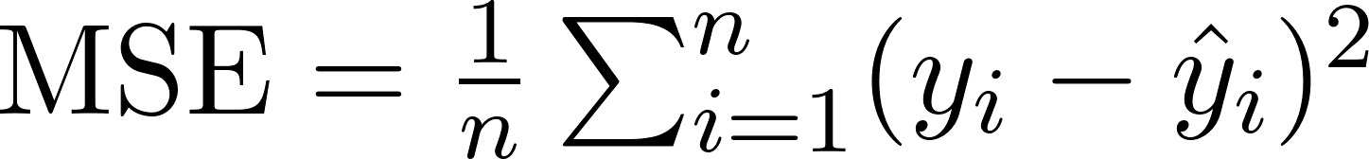
Mean Squared Error
KNOW THIS!!!
Mean Squared Error (MSE)
Represents the average of the squared differences between predicted and actual values.
Formula
Where (y_{i}) = actual value, (ŷ_{i}) = predicted value, (n) = number of samples.
Meaning & Use
Size Matters: Larger values indicate worse performance.
Sensitivity: Outlier data have undue effect due to squaring.

Slide 24
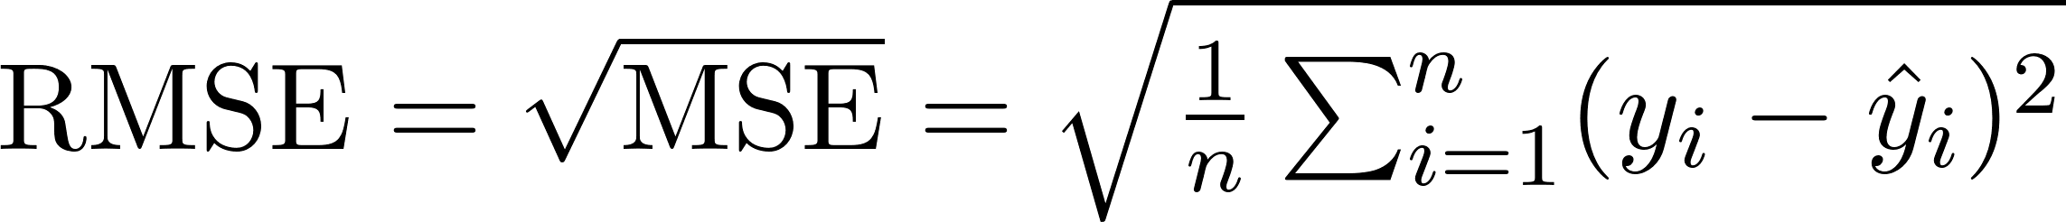
Root Mean Squared Error
KNOW THIS!!!
Root Mean Squared Error (RMSE)
Represents the square root of MSE, giving a measure of error in the same units as the output.
Formula
Where (y_{i}) = actual value, (ŷ_{i}) = predicted value, (n) = number of samples.
Meaning & Use
Size Matters (Less): Like MSE, larger values are worse, but due to the square root, it’s useful against outlier values. RMSE's unit is the same as the dependent variable.
Interpretability: Easier to interpret than MSE since it's on a similar scale to the original data.

Slide 25
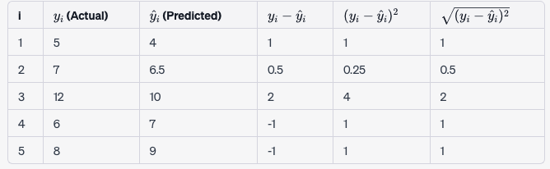
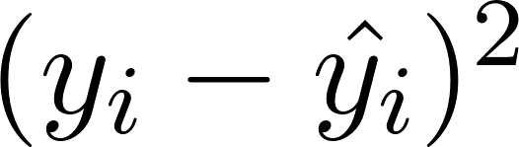
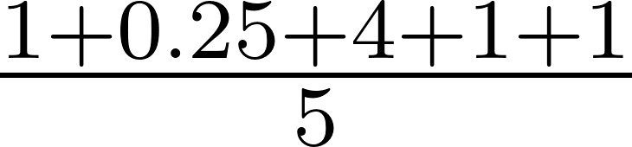
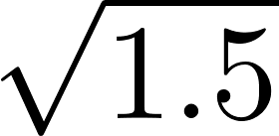
(Root) Mean Squared Error in Practice
Mean Squared Error (MSE): Average of = = 1.5
RMSA: Square root of MSE = ≈ 1.2

Slide 26
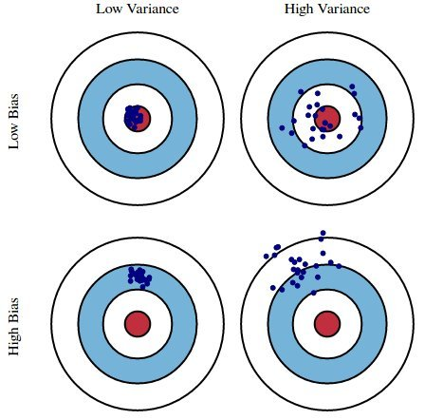
Bias and Variance
KNOW THIS!!!
Bias: Tendency of an in-sample statistic to over or underestimate the statistic in the population
Variance: Tendency to noisily estimate a statistic. E.g., sensitivity to small fluctuations in the training dataset.

Slide 27
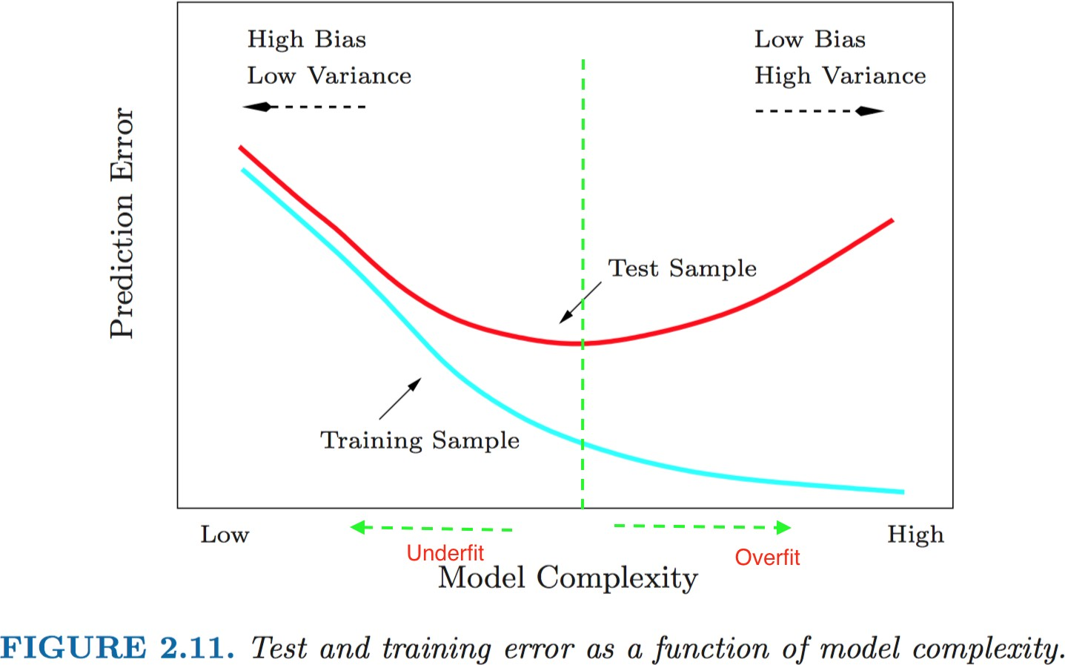
Bias-Variance Tradeoff
Error in Training sample (~bias) ↓ as we ↑ model complexity (e.g. number of variables)
Error in Test sample (~variance) ↑ as we ↑
Key: finding optimal model complexity

Slide 28
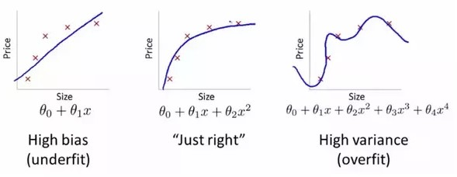
Optimal Model Complexity: Neither Underfit Nor Overfit

Slide 29
Lab 8

